Slide 1

AirBnB Project Presentation
Isaiah Erb and Jason Koff

Slide 2

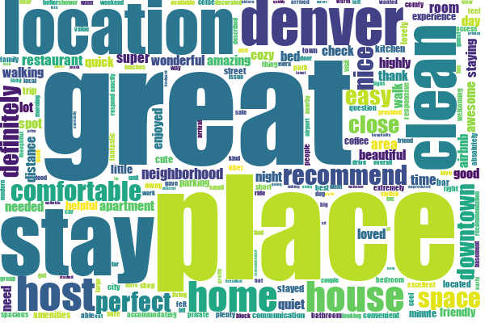
Text Preprocessing
Removed
Special characters
Null comments
Default stopwords
Non-english words
Uppercases

Slide 3
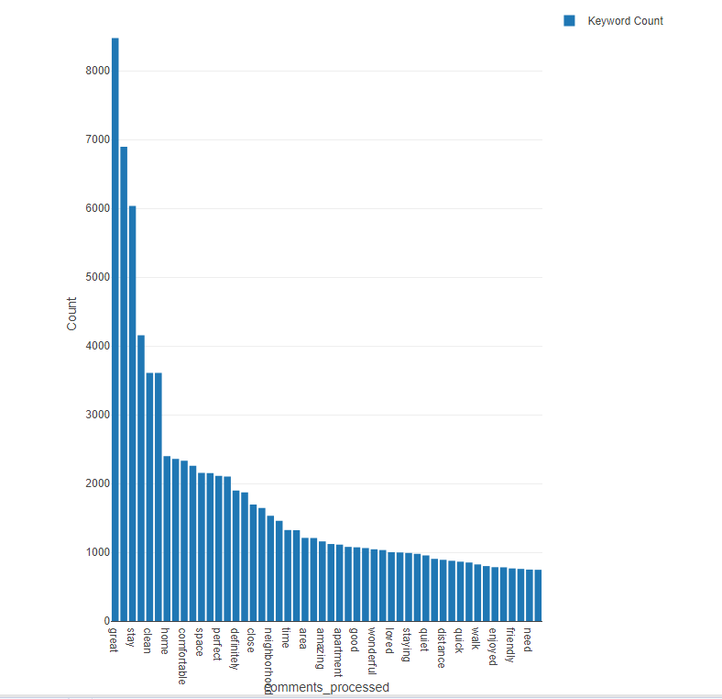
Explorative Question: What are the Top Keywords Mentioned in the Textual Reviews?
The top 5 keywords were all used over 3,000 times
The most used keyword was great with over 8,000 uses
Top 5 keywords included
great
place
stay
location
clean
A commonality seen among these words is a positive sentiment

Slide 4
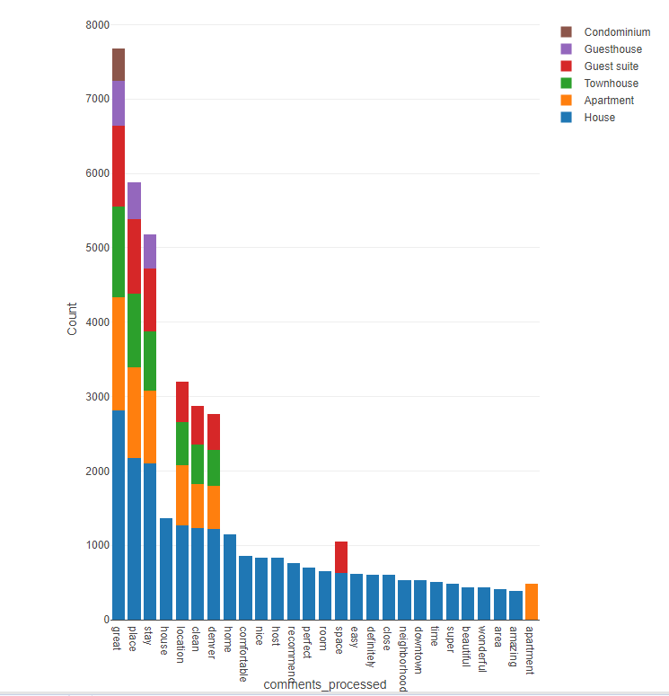
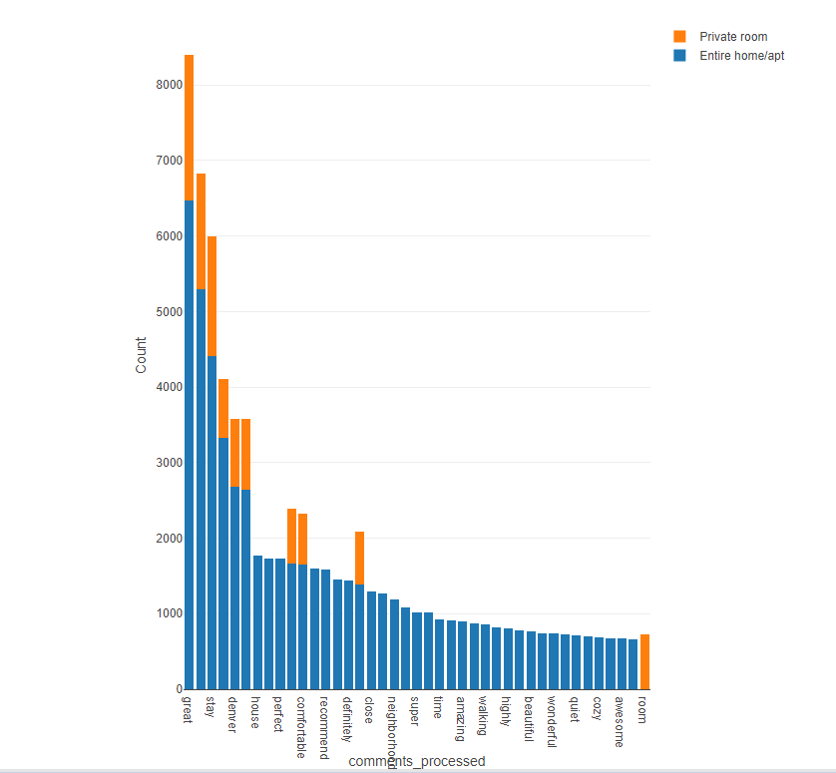
Explorative Question: How do the Top Keywords Vary Among Property and Room Types?
Many keywords were repeated in both property and room types
Most have positive sentiments
Houses had the most keywords, followed by apartments and townhouses
Entire apartments/homes had more keywords associated with them than private rooms

Slide 5
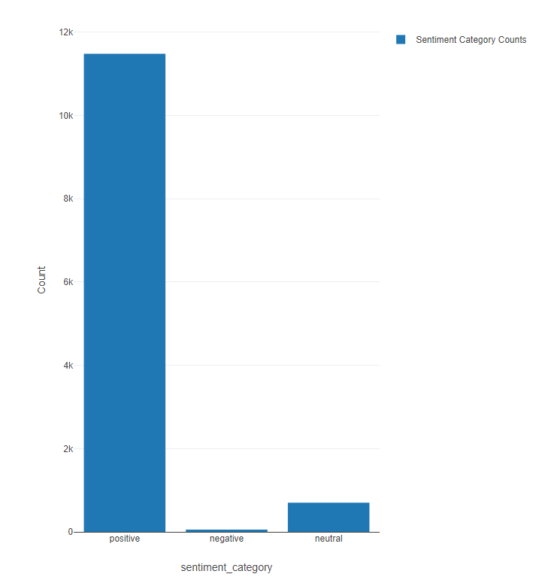
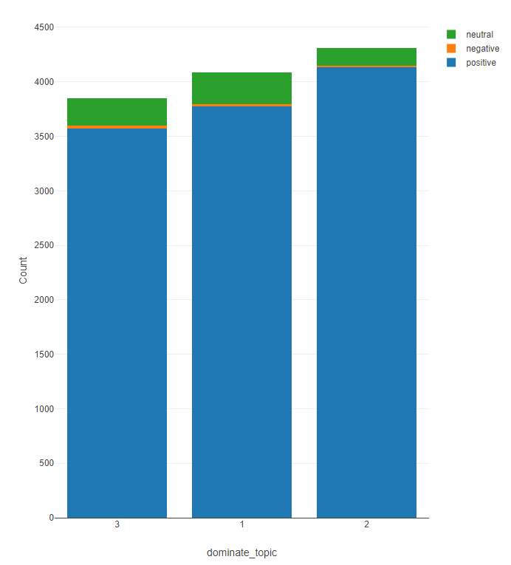
Explorative Question: What is the Overall Sentiment of All Textual Reviews? Sentiments by Topic?
Overwhelmingly positive sentiment overall
Topic 1 (Property Details) had the most negative keywords

Slide 6
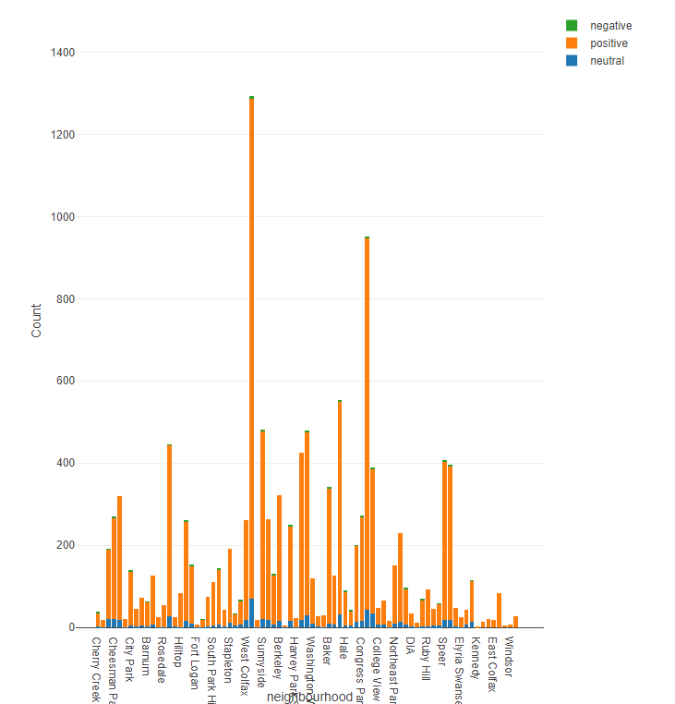

Explorative Question: How Does Sentiment Vary Across Different Neighborhoods?
Mostly positive keywords associated with each neighborhood
Five Points had the most, followed by Highland and Capitol Hill

Slide 7
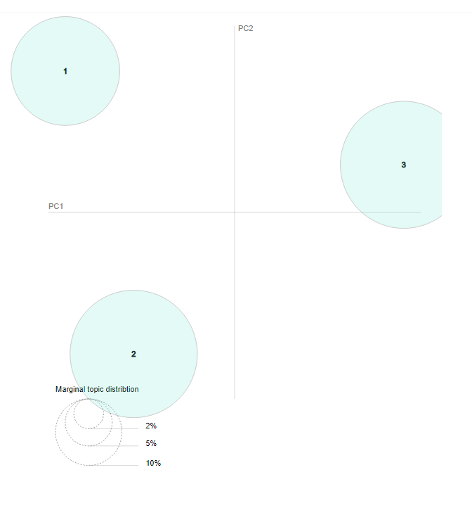
What Topics Were Found?
Topic 1: Property Details (26.8%)
stay
space
spot
house
cozy
Topic 2: Guest Experience (36.7%)
clean
host
quick
amazing
comfortable
Topic 3 Neighborhood Details (36.5%)
downtown
neighborhood
denver
parking
area

Slide 8

Predictive Modeling
We made two linear regression models for the target variable price
With text: 18 variables
Without text: 28 variables
For these models we sampled using a 60:40 training to validation split
Adj R-Squared
With text: 0.210
Without Text 0.204
Mean Squared Error
With text: 24,079.574
Without text: 23,846.122
The models proved predictive capabilities, but are not the strongest predictors of price
The with text model outperformed the without text model
Even though with text was a better performer the models are very comparable in predictive capacities

